Slide 1
Responsive web design
WWCODE-KL

Slide 2


Slide 3
One website, Many devices.

Slide 4
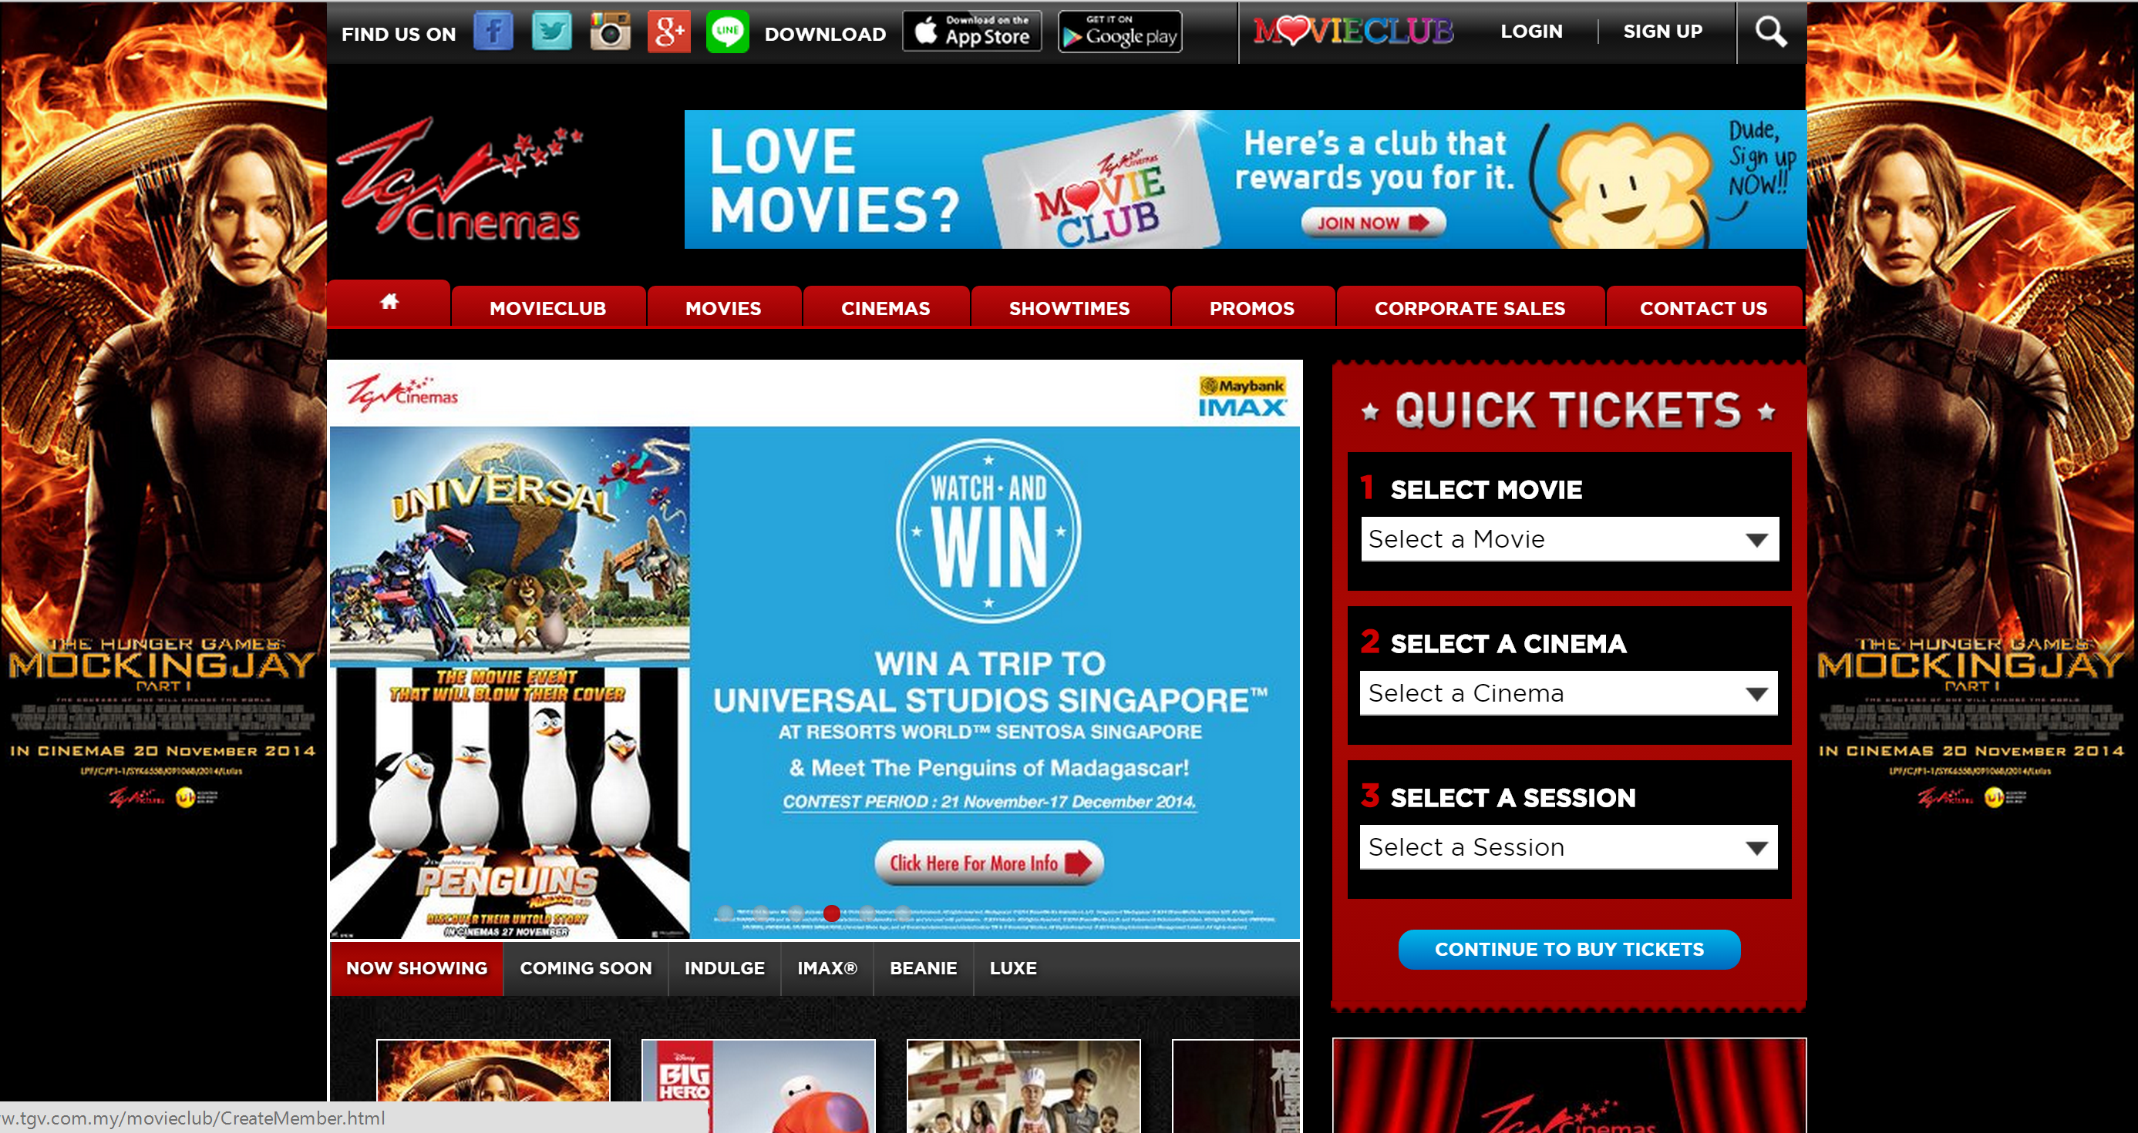
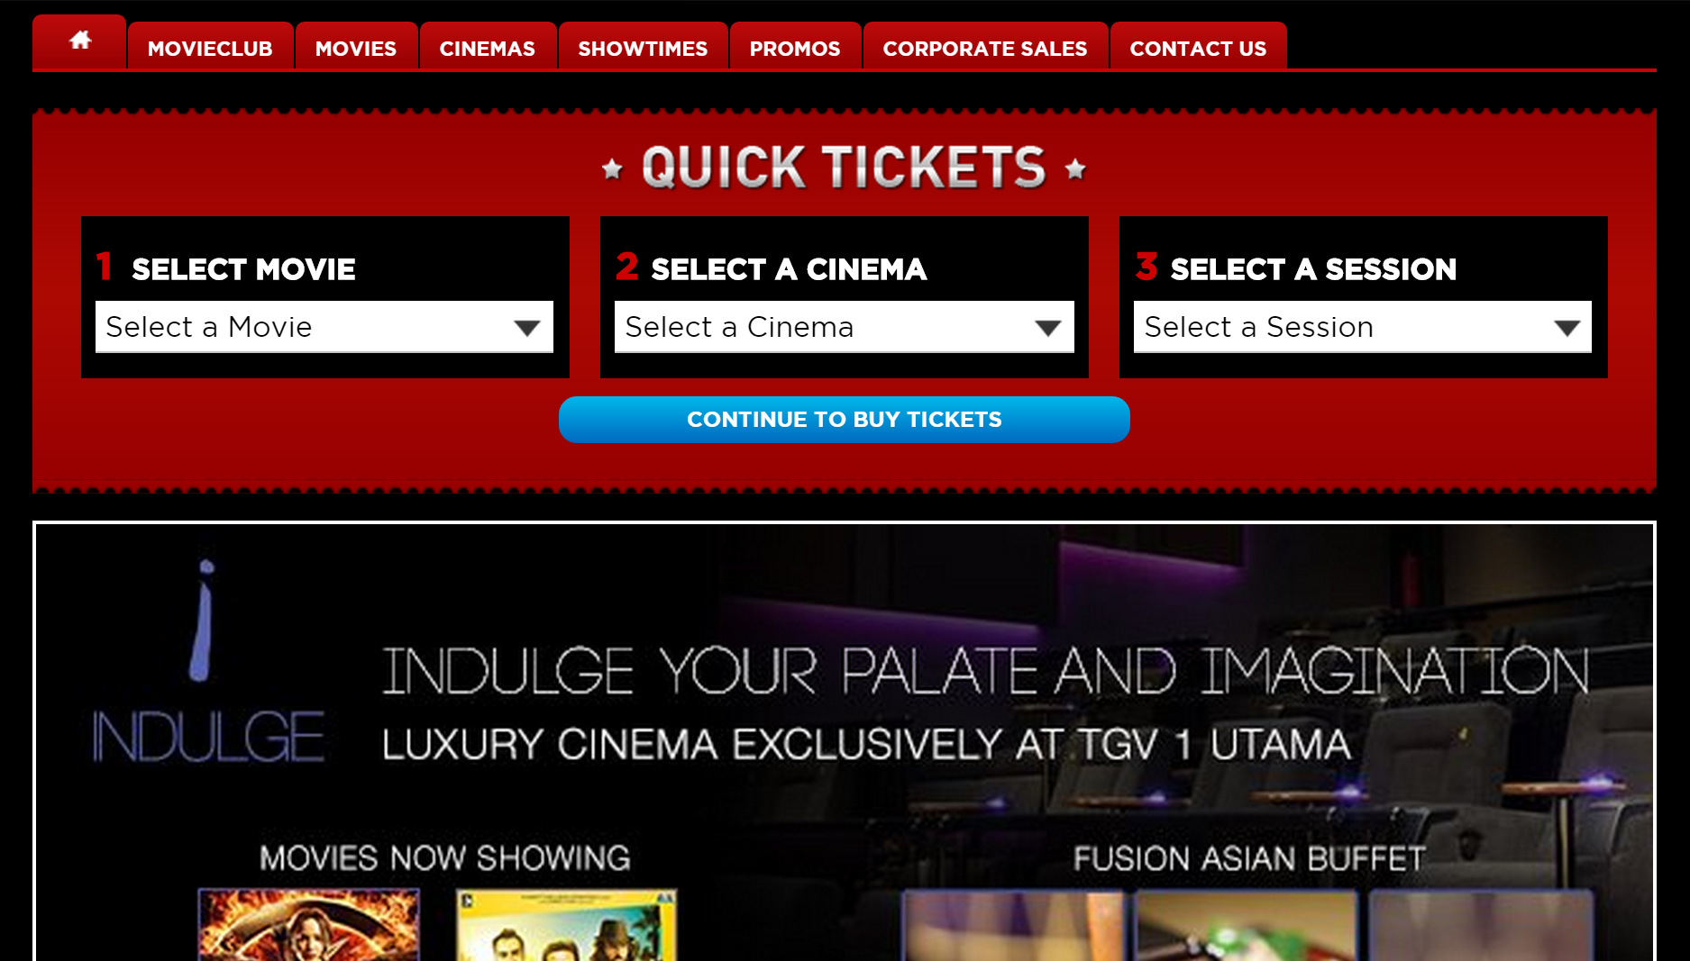
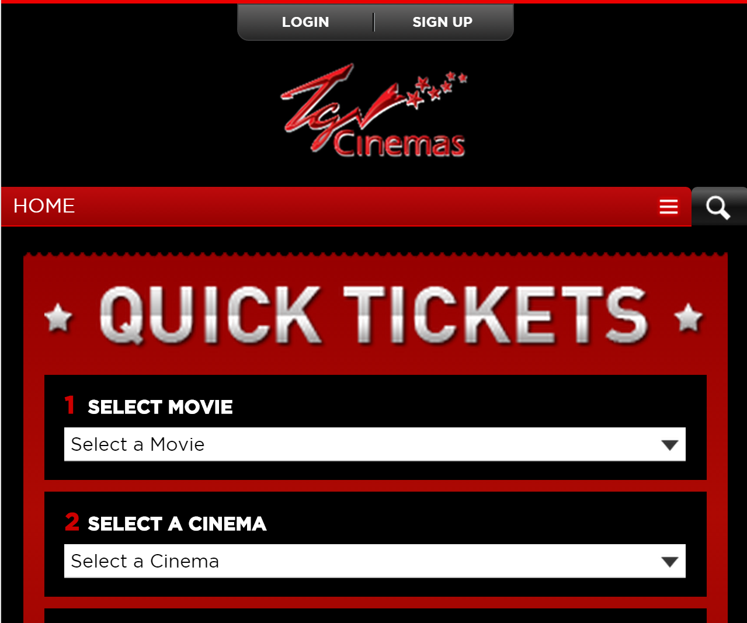
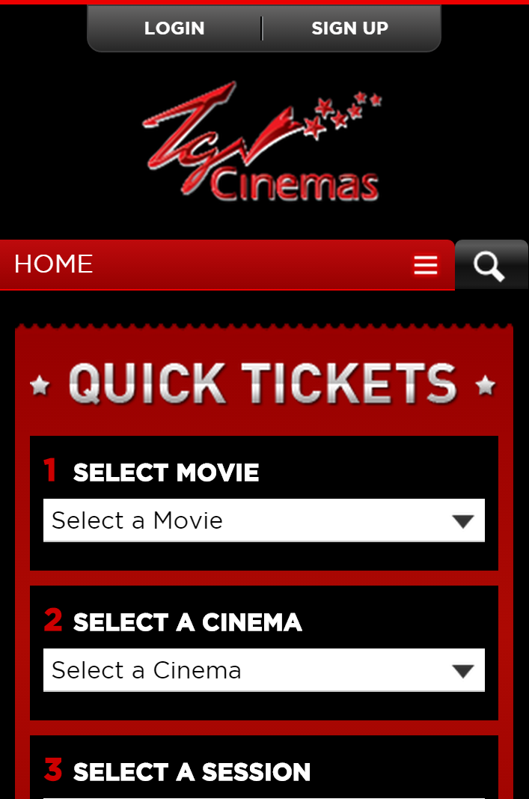
Example: www.tgv.com.my

Slide 5

Nice. But how?

Slide 6
CHALLENGE

Slide 7
Build your own responsive portfolio.

Slide 8




Slide 9

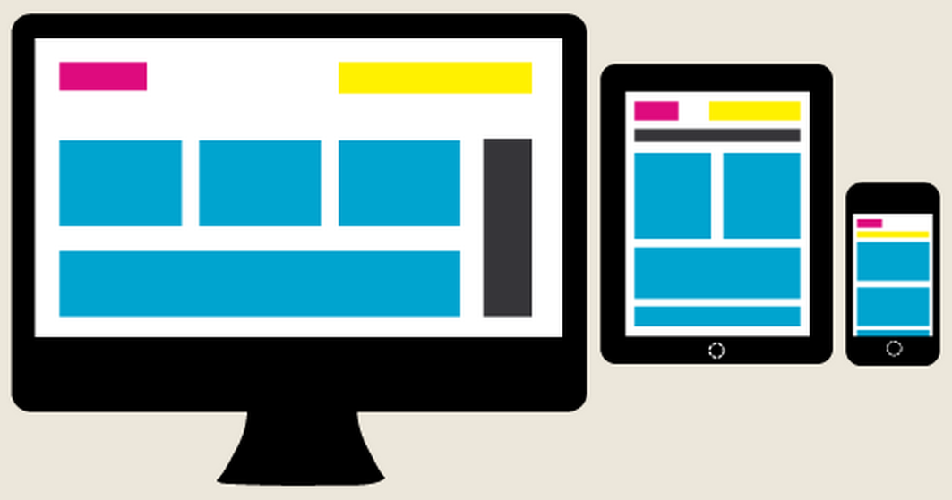


STEPs
1. Decide on your content.
2. Design the layout.
3. (Optional) Pick a framework.
4. Let’s code!

Slide 10
Some idea on portfolio
http://ironsummitmedia.github.io/startbootstrap-freelancer/
http://chanchandrue.net/themes/rangda/
http://sainathchillapuram.com/BS/ts/
http://jennylynpereira.com/demo/html/myFolio/
http://myxvip.com/papel/

Slide 11



Minimal tools
Browser
Text editor
CSS Framework
Starter kit: www.github.com
Bootstrap 3: http://getbootstrap.com/getting-started/#download

Slide 12
Nice to have tools
Visual studio web express or community version:
http://www.visualstudio.com/products/visual-studio-express-vs
HTML5 boilerplate:
http://html5boilerplate.com/
Nice bootstrap theme @ Bootswatch:
http://bootswatch.com
Nice icon @ Font awesome:
http://fortawesome.github.io/Font-Awesome/
Beautiful image modal @ Lightbox for bootstrap 3:
http://www.jasonbutz.info/bootstrap-lightbox/
Nice color scheme @ Adobe CC
https://color.adobe.com/explore/newest/?time=all
CSS Gradient helper
http://www.cssmatic.com/

Slide 13




Some useful kick start
HTML5 for absolute beginners
http://www.microsoftvirtualacademy.com/training-courses/html5-css3-fundamentals-development-for-absolute-beginners
The famous W3schools
http://www.w3schools.com/

Slide 14
References
Responsive frameworks
http://designinstruct.com/roundups/html5-frameworks/
http://mashable.com/2013/04/26/css-boilerplates-frameworks/

